Slide 1
Tutorial 8
Servlet- Java Rest Service Junit Testing
CS551 Advanced Software Engineering
UMKC

Slide 2
Topics to cover
Java - Servlet
Rest Services
Junit Testing
MongoDB
MongoLab

Slide 3
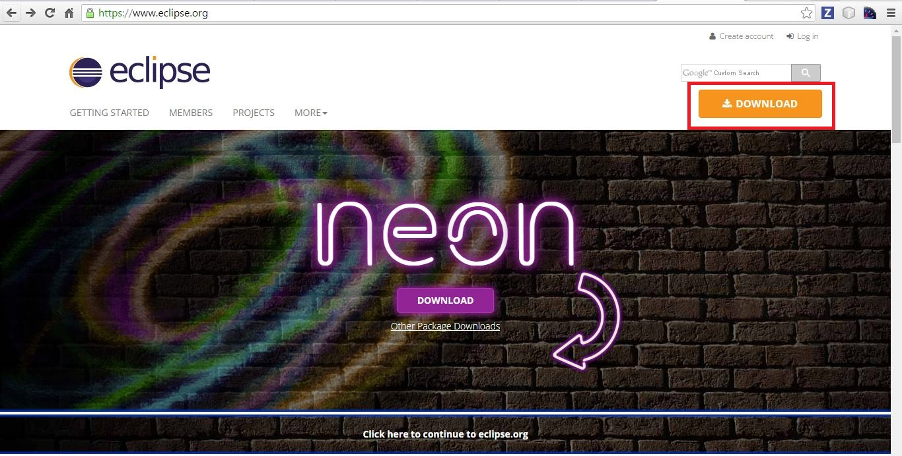
Eclipse Installation

Slide 4
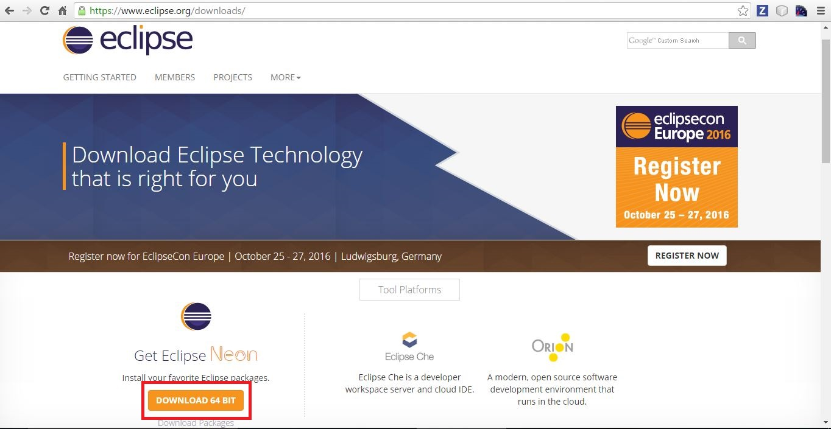

Slide 5
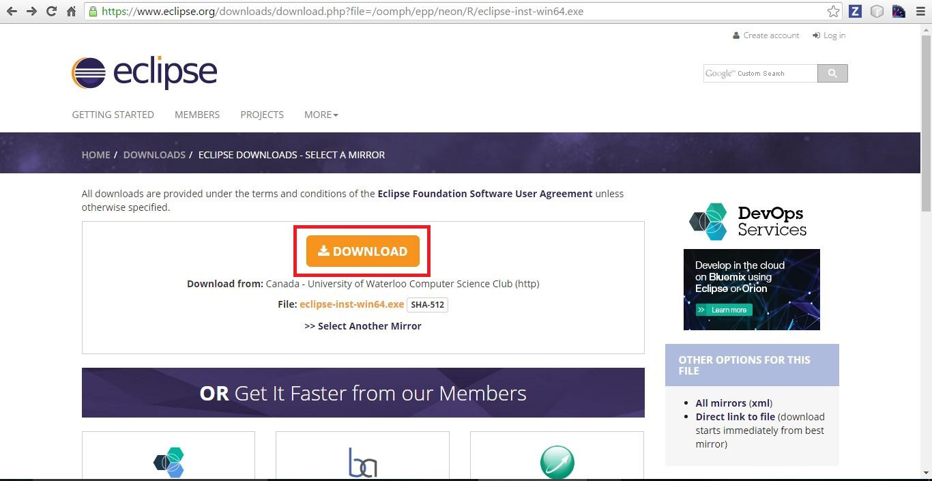

Slide 6
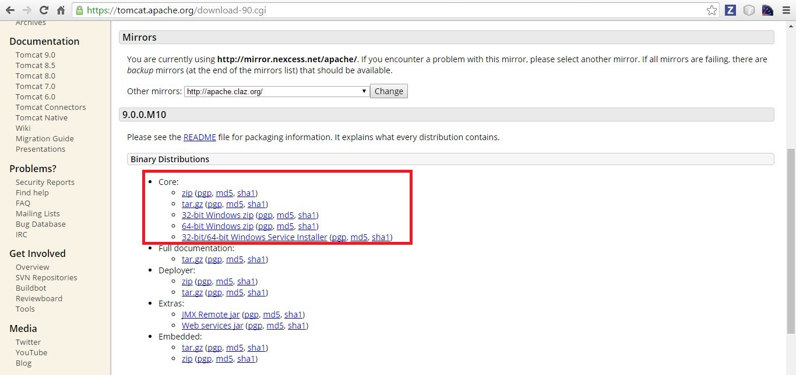
Apache Tomcat Application Server
Apache Tomcat, a server for Java applications from Apache.
https://tomcat.apache.org/download-90.cgi

Slide 7
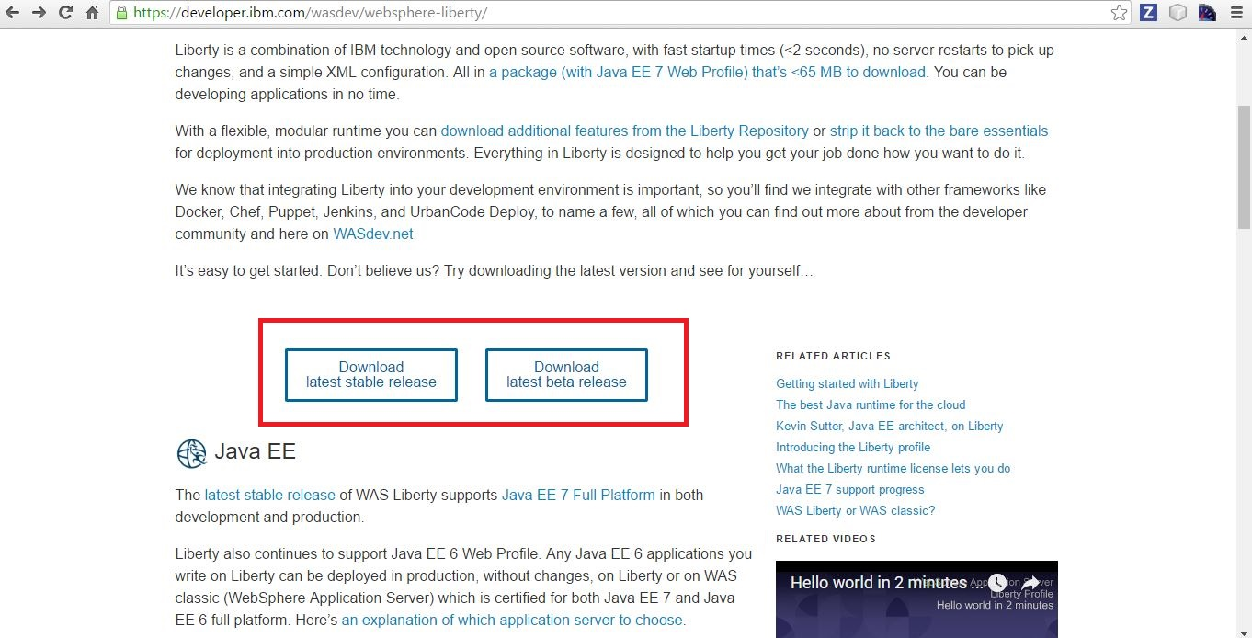
IBM Websphere Application Server (optional)
Similar to Apache Tomcat, a server for Java applications from IBM.
https://developer.ibm.com/wasdev/websphere-liberty/

Slide 8
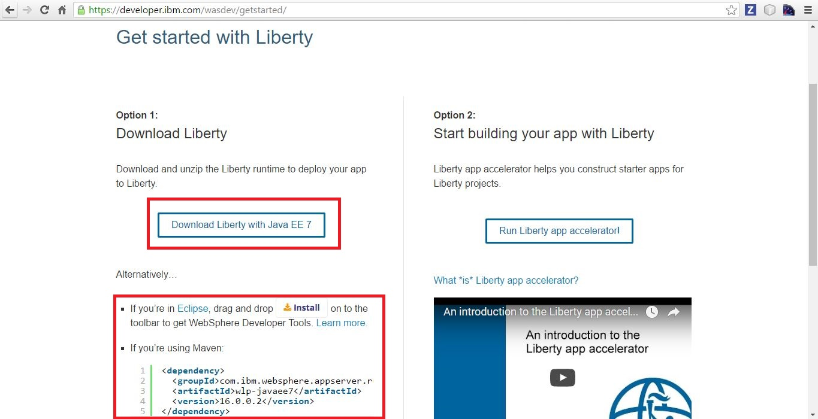
Configure for Eclipse
Drag and drop the install button on to eclipse.
OR
Follow the other method.

Slide 9
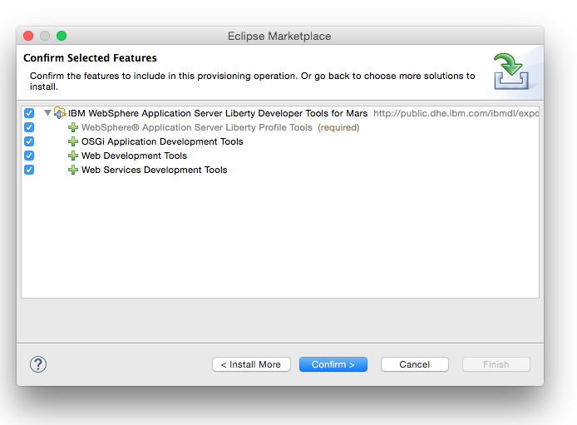
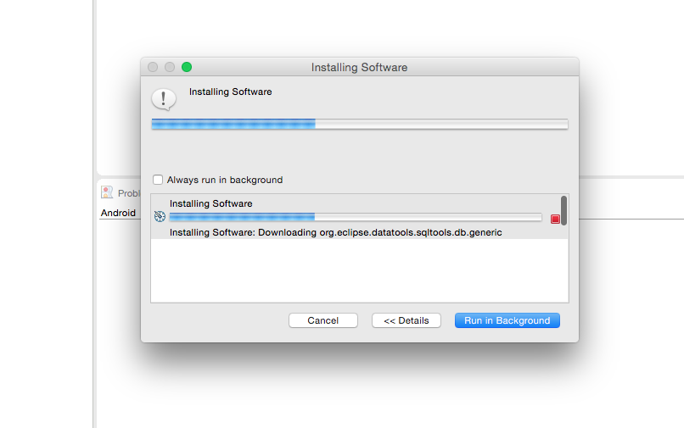
Installing WebSphere plugin on Eclipse

Slide 10
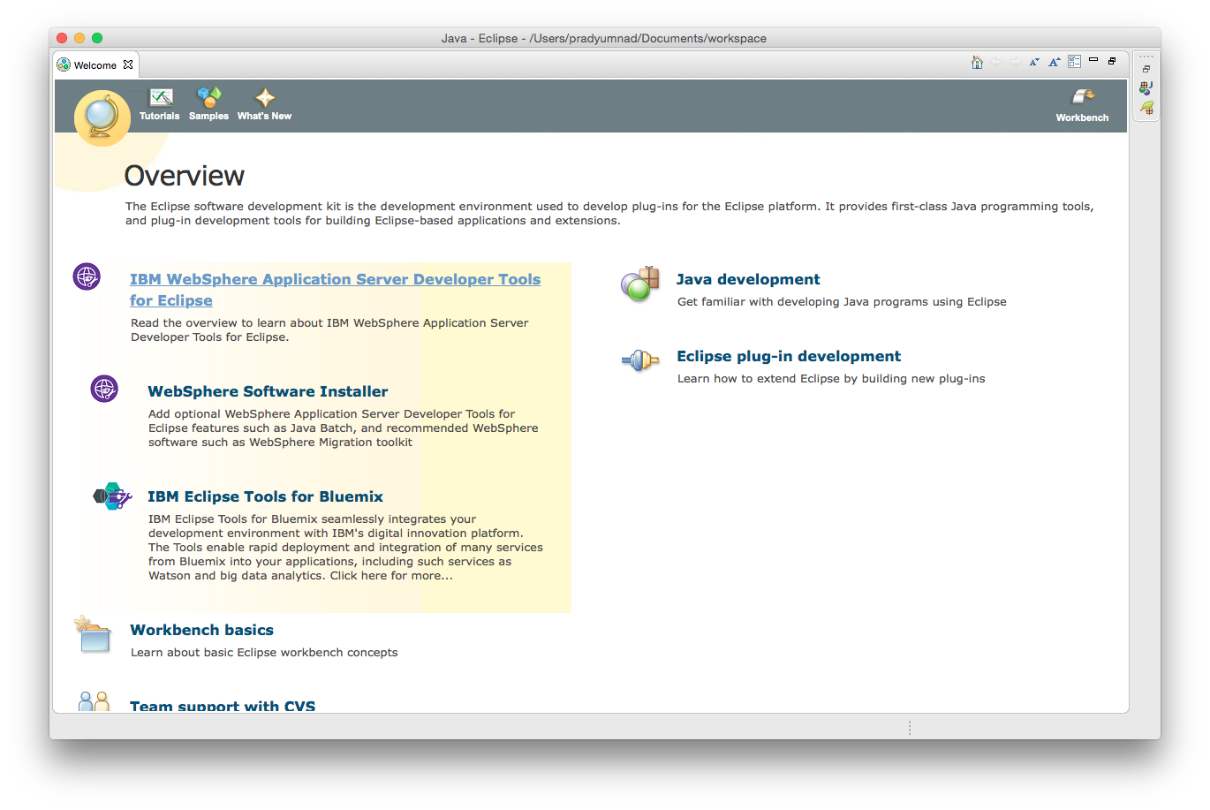
IBM WebSphere installed on Eclipse

Slide 11
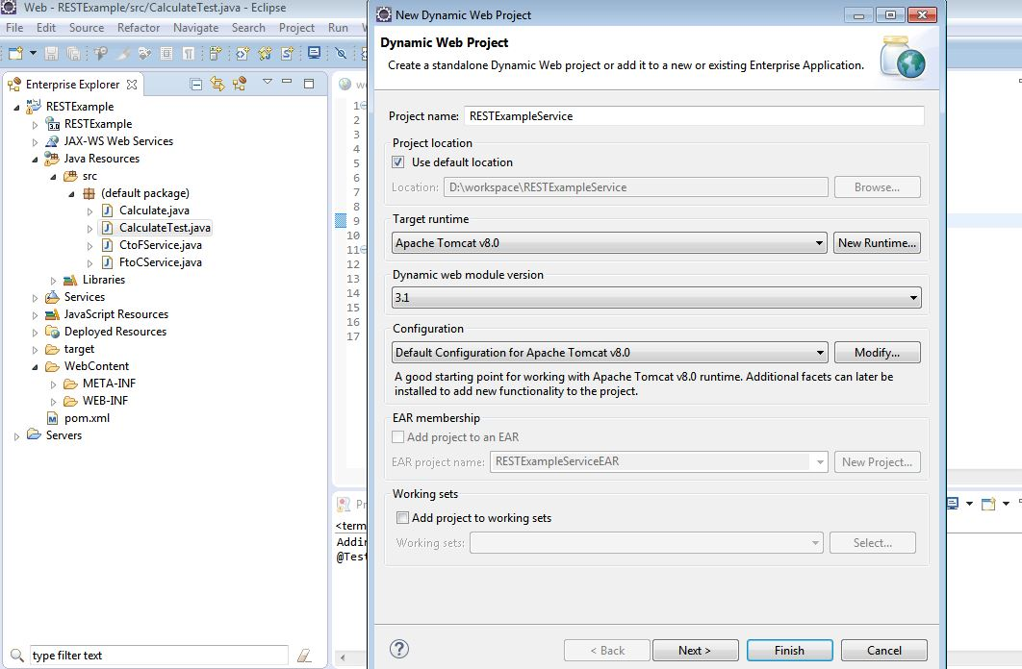
In Eclipse => File => New => Dynamic Web Project. Name it as “YourRESTprojectName“.

Slide 12
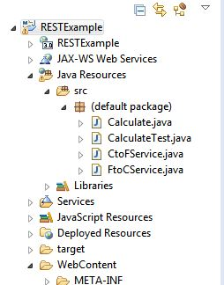
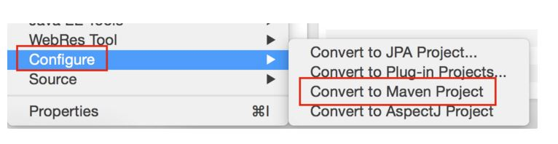
Now convert Project to Maven Project so we could add required .jar files as dependencies. Steps: Right click on project -> Configure -> Convert to Maven Project.

Slide 13
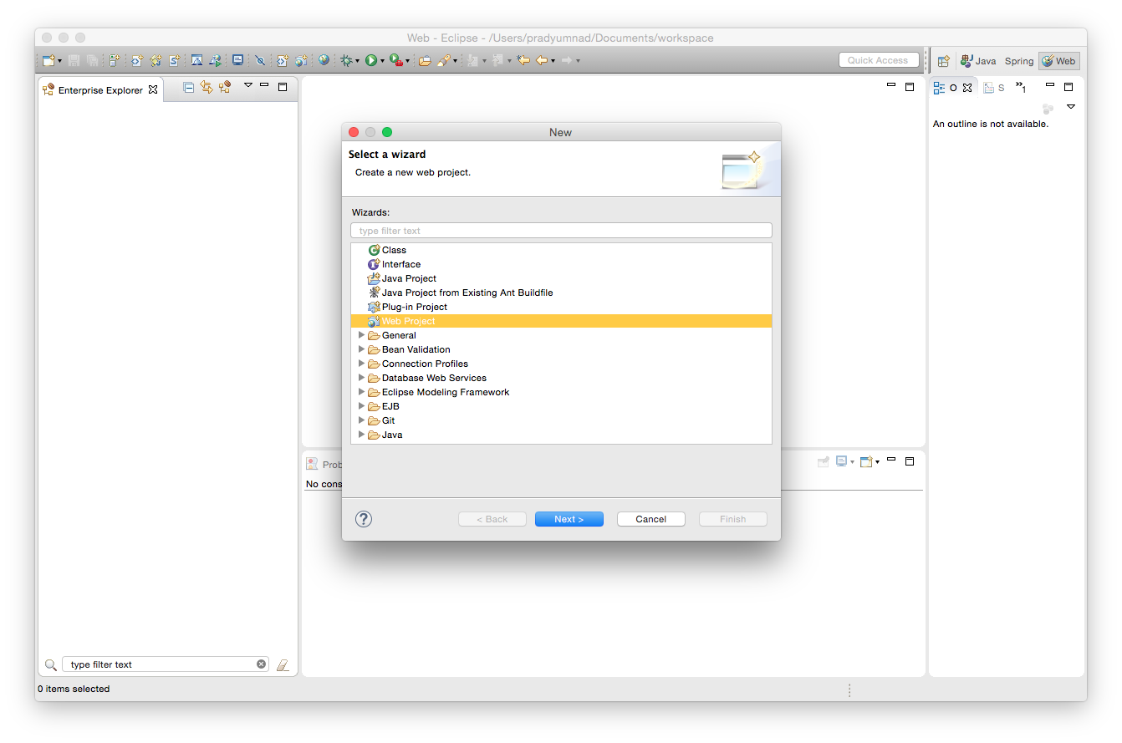
Create New Web Project (If Liberty plugin is enabled )

Slide 14
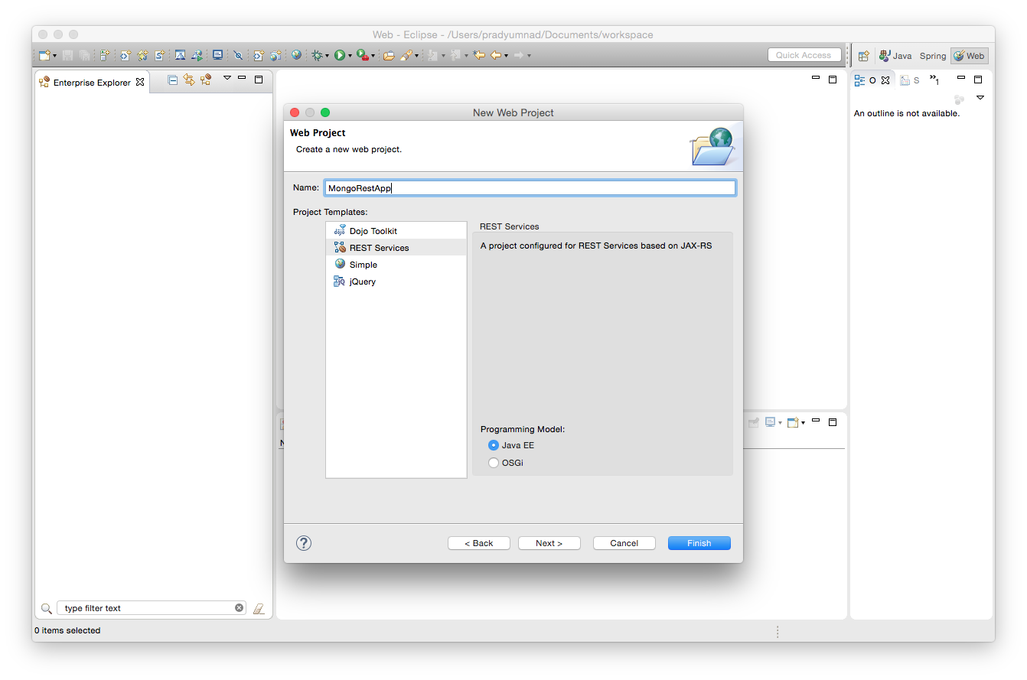
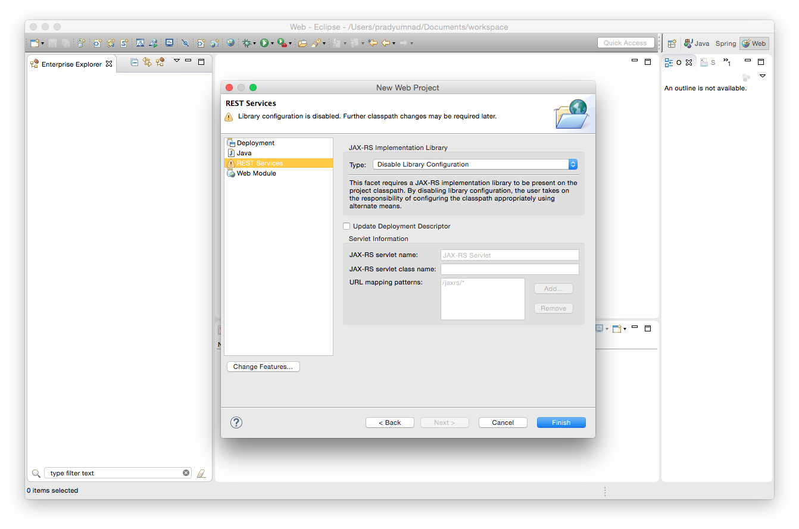

Slide 15
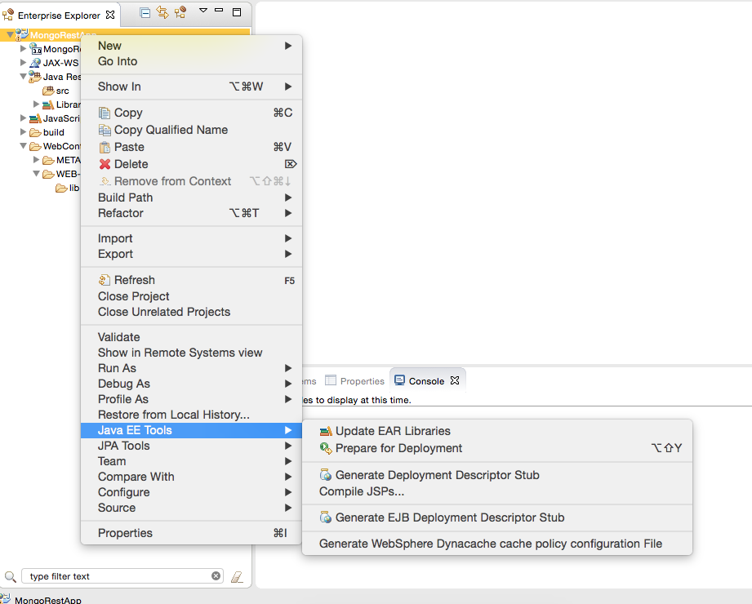
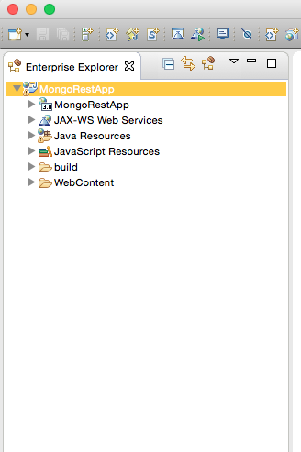
web.xml creation

Slide 16
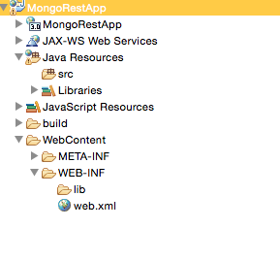
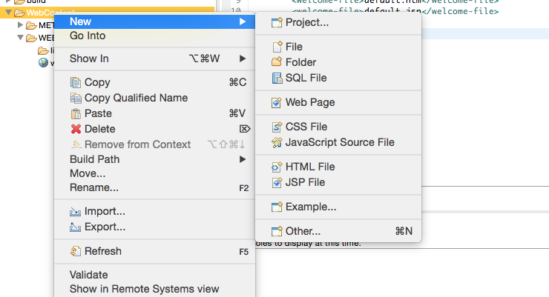
Index.html creation

Slide 17
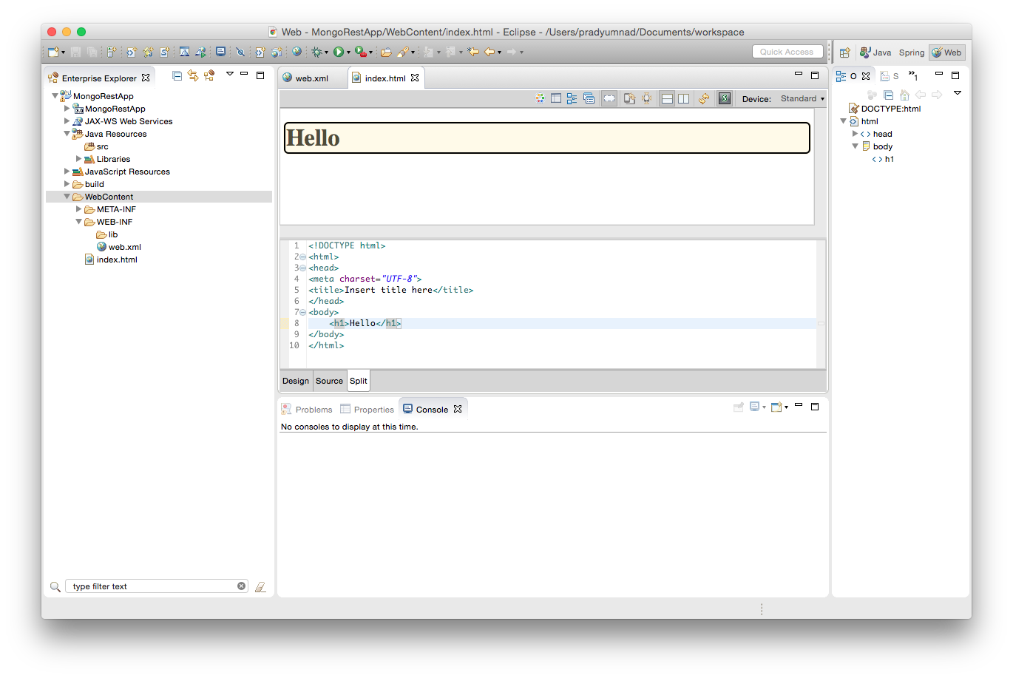
index.html creation
Change your
index.html

Slide 18
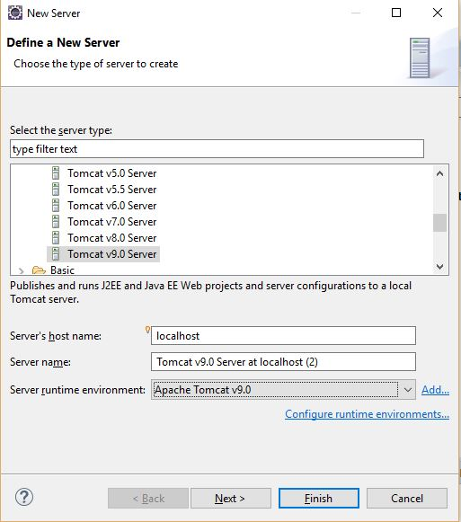
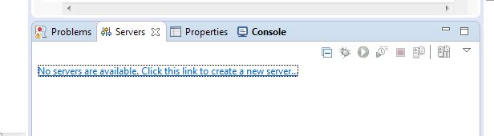
Server Creation

Slide 19
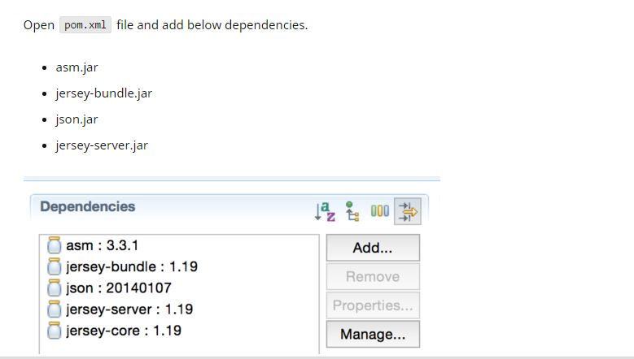
Add Dependencies in pom.xml

Slide 20
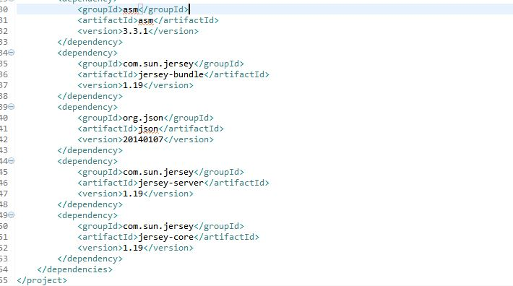
Pom.xml after adding dependencies

Slide 21
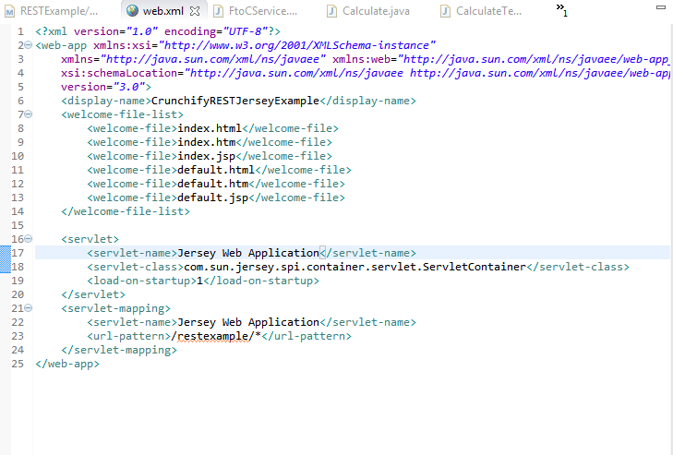
Your Web.xml

Slide 22
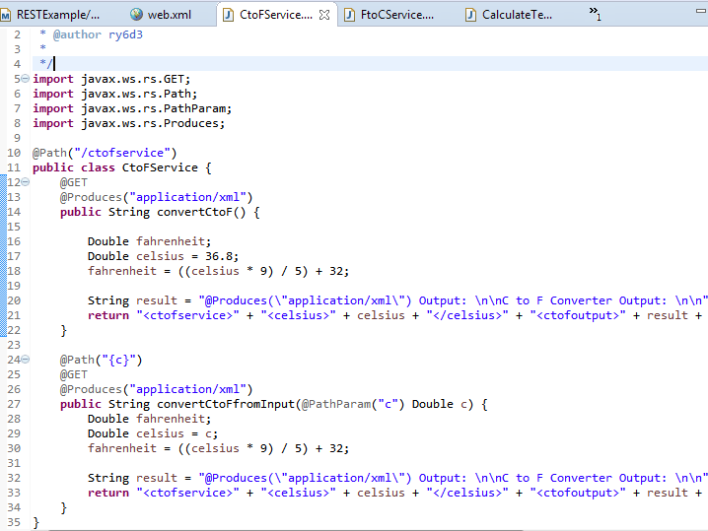
Add a Class in your project

Slide 23
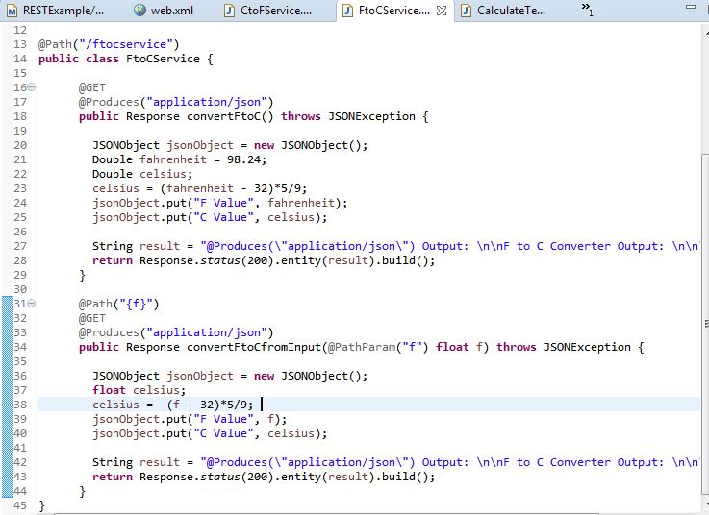
Add a Class in your project

Slide 24
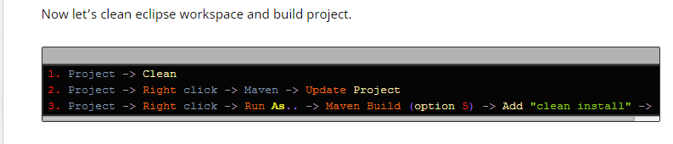
Maven clean and update
Click on Project

Slide 25
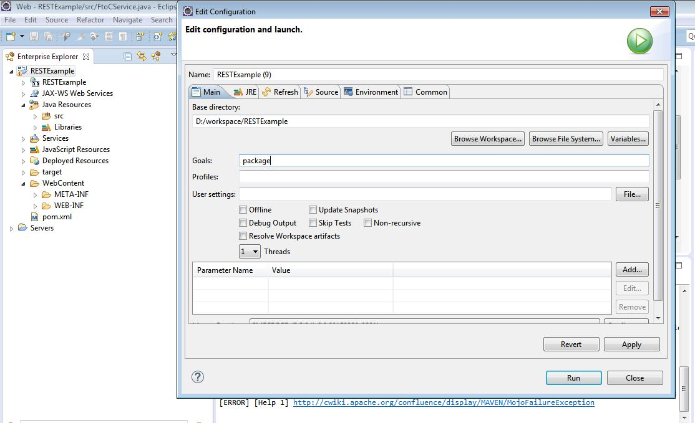
Finally , Run as -→Maven Build

Slide 26
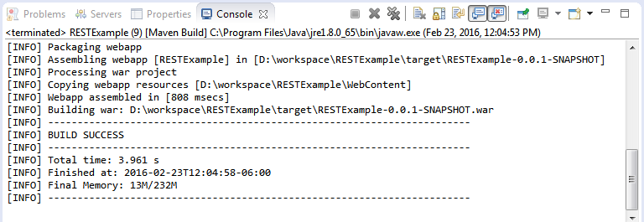
Build Success message

Slide 27
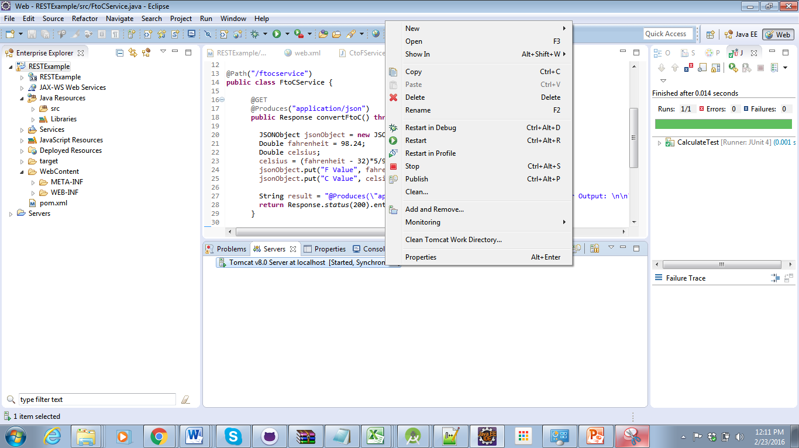
Start your Tomcat

Slide 28
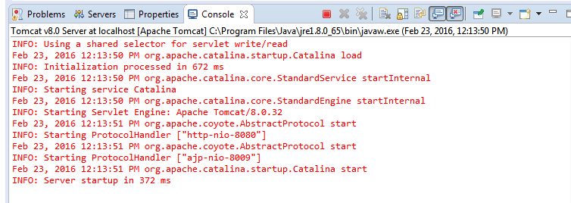
Tomcat success Message

Slide 29
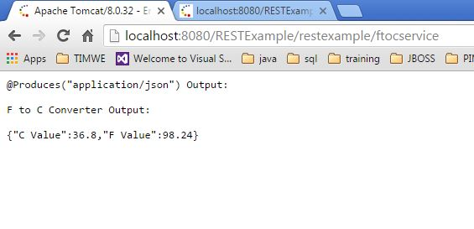
Run

Slide 30
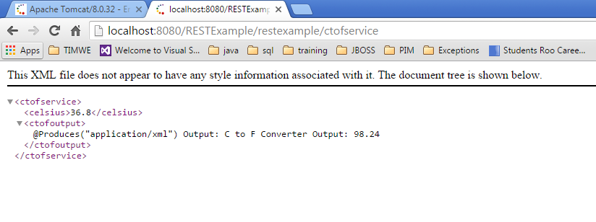
Run

Slide 31
MongoDB

Slide 32
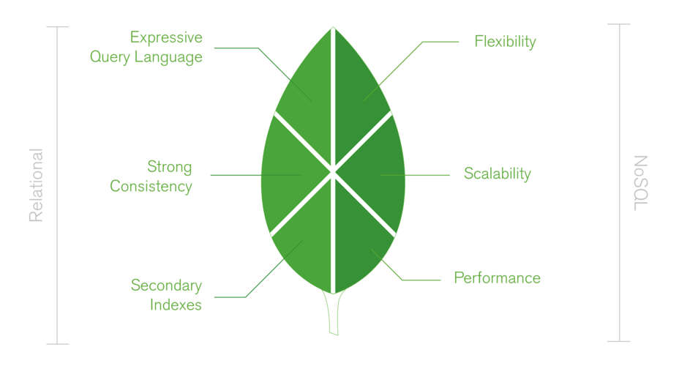
Intro

Slide 33
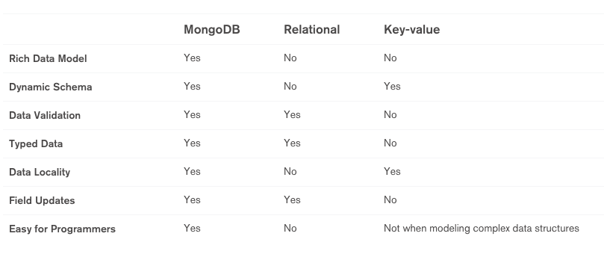
Comparison

Slide 34
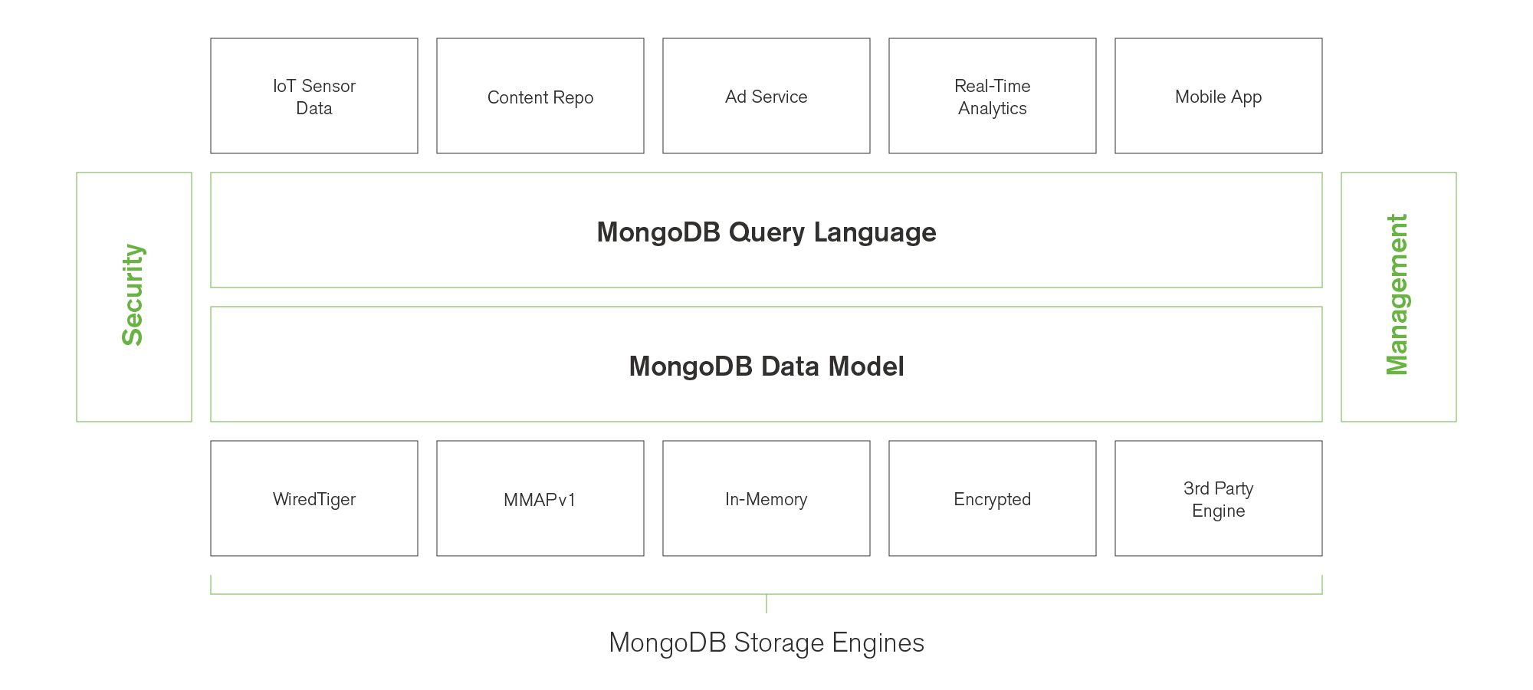

Slide 35
Accessing MongoDB in MongoLab

Slide 36
MongoLab(Now Mlab)
https://mlab.com
MLab is a fully managed cloud database service that hosts MongoDB databases.
MLab runs on cloud providers Amazon, Google, and Microsoft Azure, and has partnered with platform-as-a-service providers.
Notes:
http://ngcordova.com/docs/plugins/facebook/

Slide 37
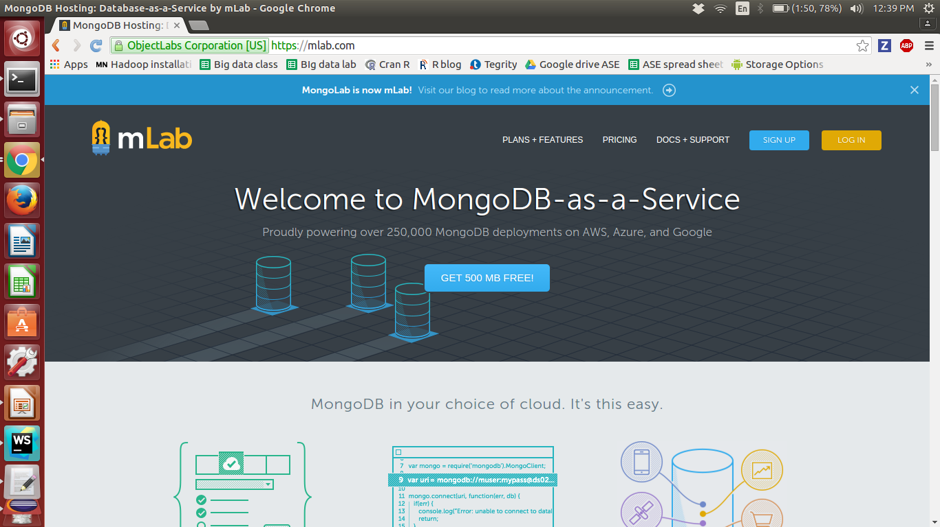
Notes:
http://ngcordova.com/docs/plugins/facebook/

Slide 38
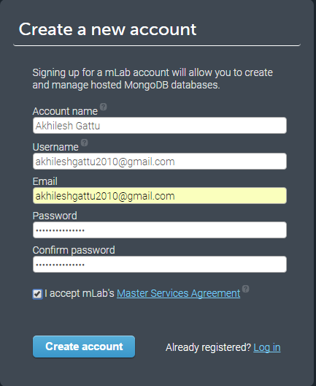
MongoLab - Sign Up
Sign up for MongoLab by providing all
the required details as shown in the
screenshot and click on Create account.
An email will be sent to the email
address you have given during sign up.
Open your email and click on the given
link to verify your email address.

Slide 39
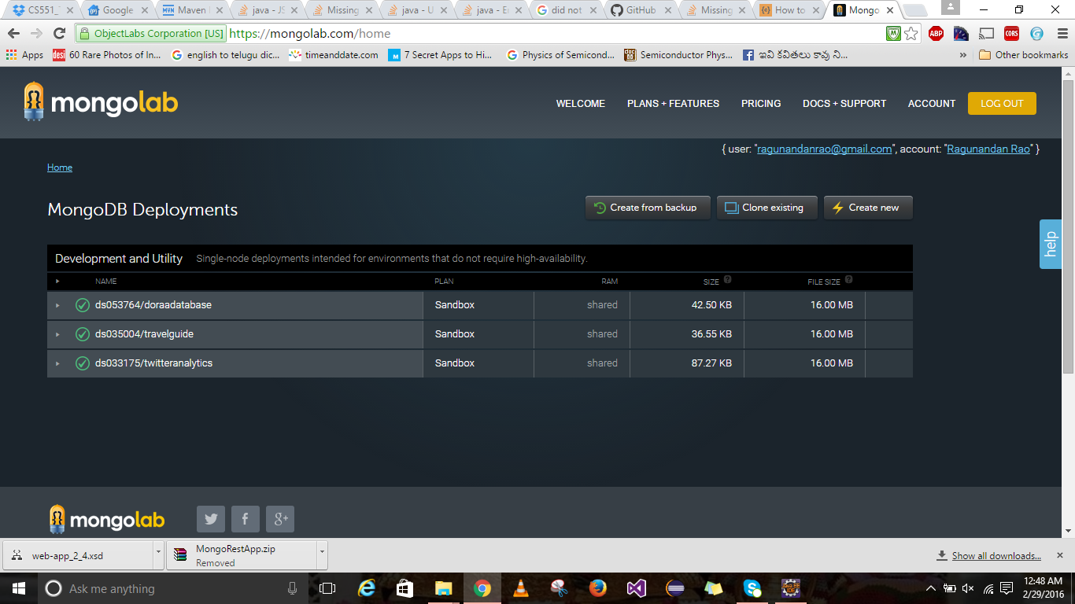
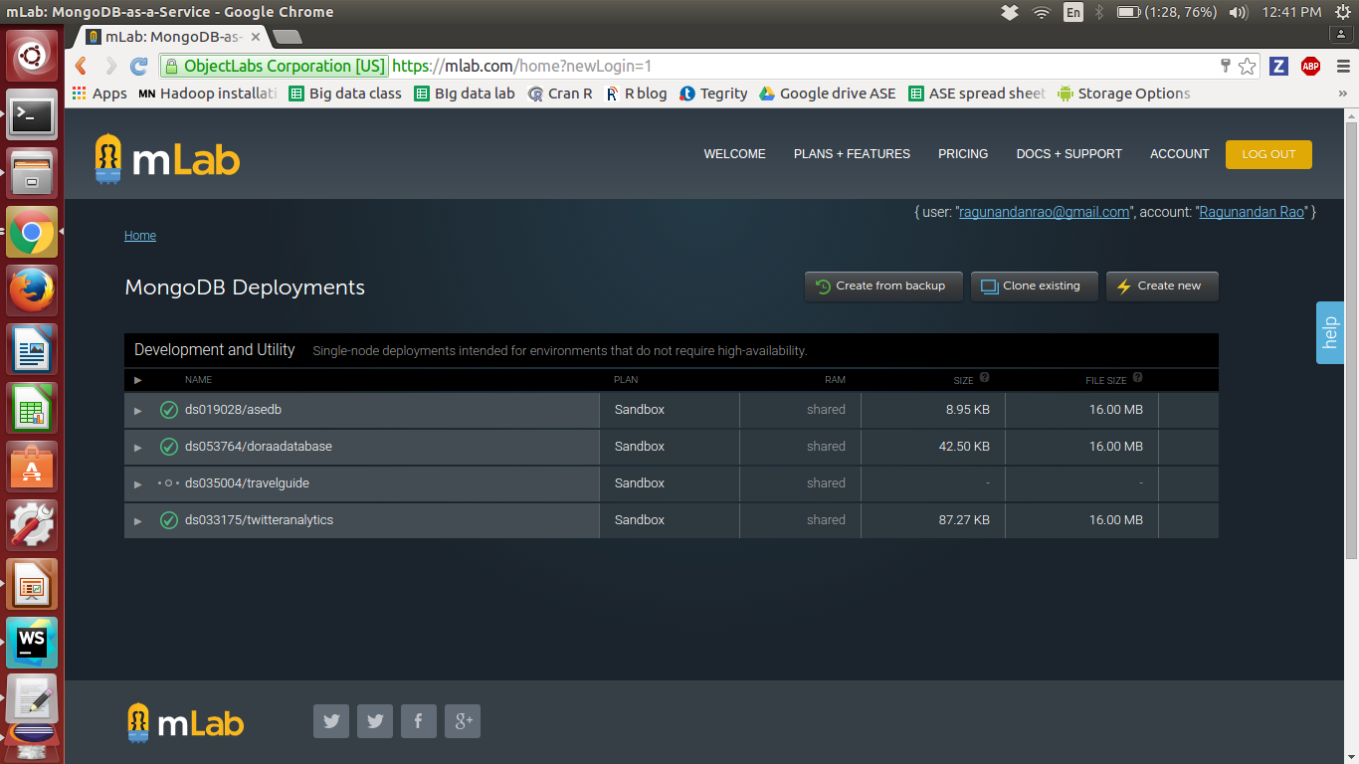
MongoLab - Management Portal

Slide 40
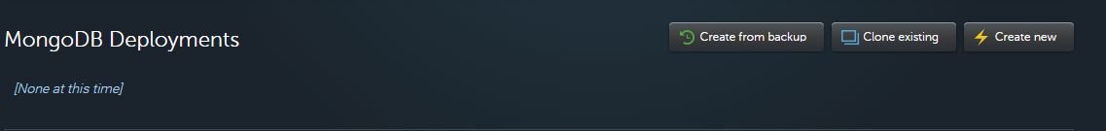
MongoLab - Create Database
Click on “Create New” button against MongoDB Deployments option in your home page
A window to create new subscription will open.

Slide 41
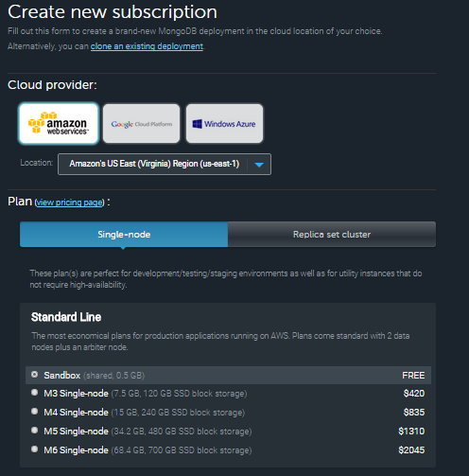
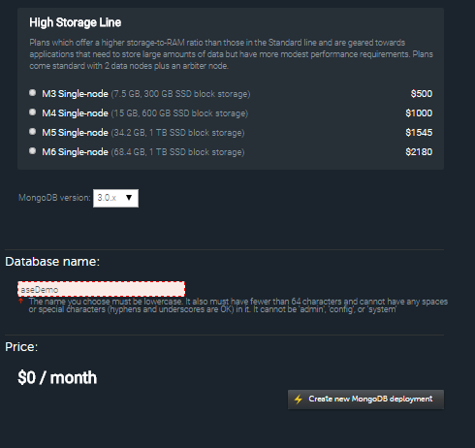

Slide 42
MongoLab - Create Database
The newly created database will be added to the MongoDB deployments as in your management portal as shown below:
Click on the database name. Your database page will open.

Slide 43
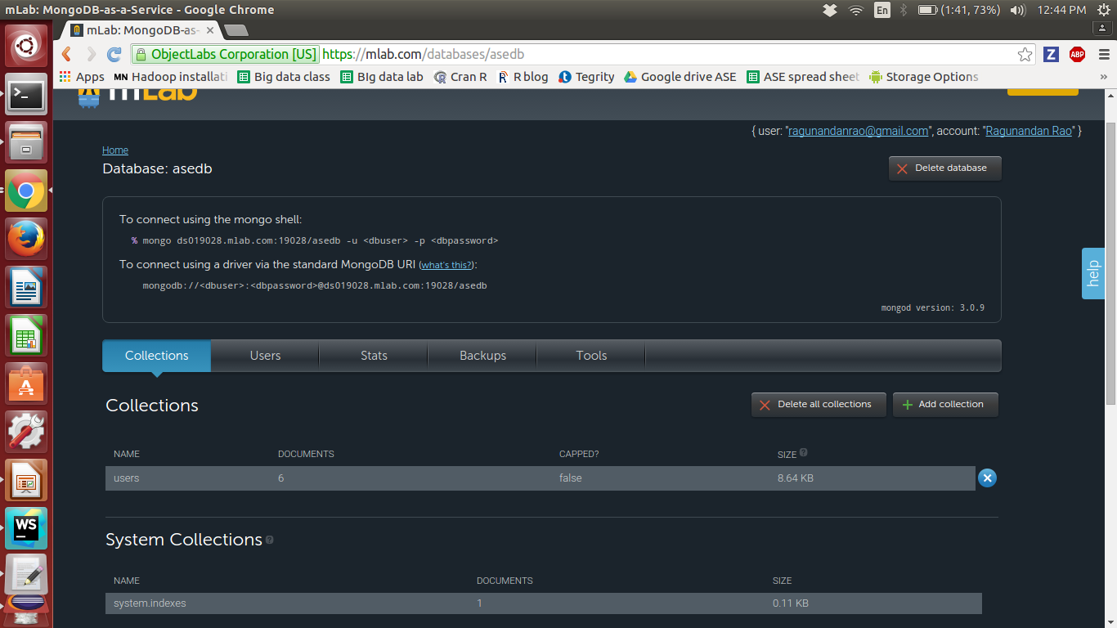
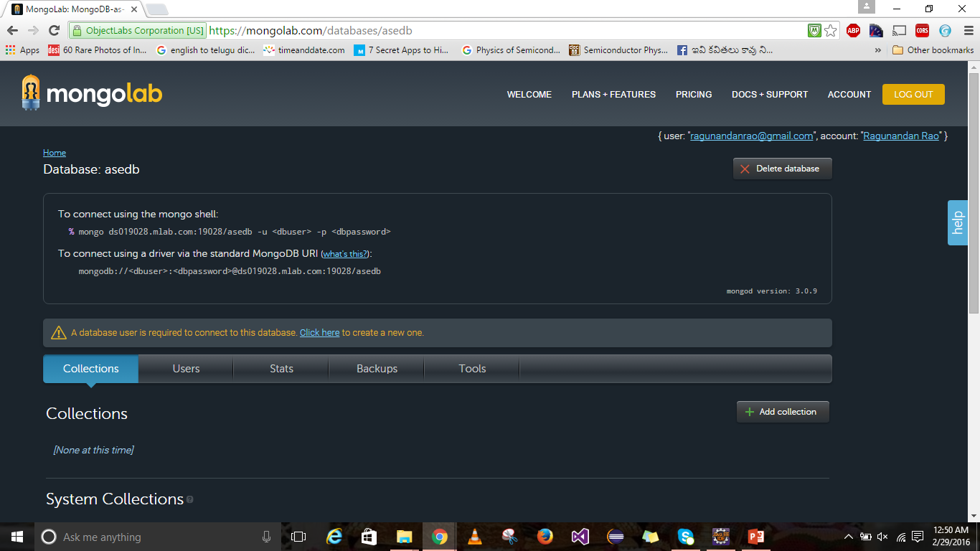
Database - Create Collection
Click on “Add Collection” in the
collections tab to created a
collection.

Slide 44
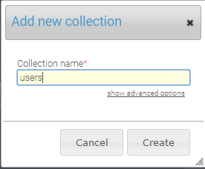
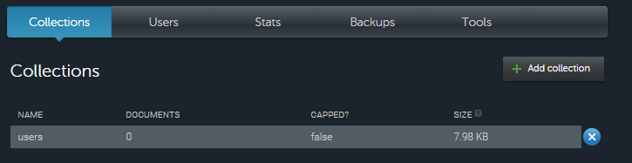
Create Collection
Provide a name for your collection and click on
create.
The collection will be displayed as shown:

Slide 45
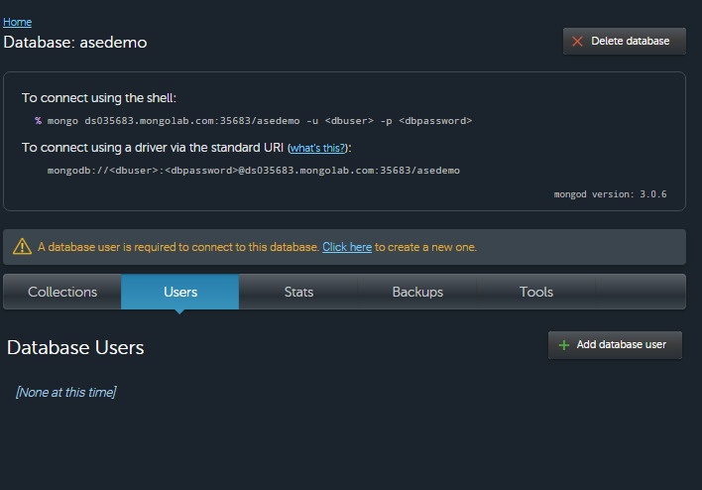
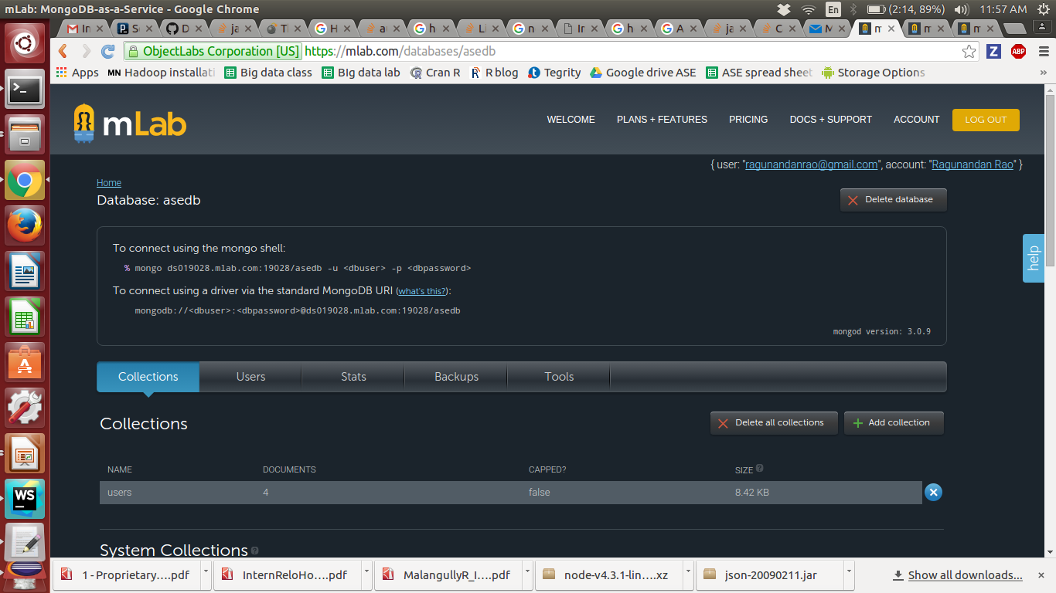
Create user
Make a note of your database
URL.
Go to the Users tab in your
database window and click
on “Add database User”
to create a new user.

Slide 46


Database - Create User
A pop window will open. Give a username and
password for your database and click on create.
To give read only access you can check the Make
read only option.

Slide 47
MongoLab - Data API
http://docs.mongolab.com/data-api/
Each MongoLab account comes with a Data API (disabled by default) that can be used to access the databases, collections and documents belonging to that account.
Each user of an account has his own API key that can be used to access the API.
Users can view or reset their API keys through the management portal.

Slide 48


Enable Data API
Click on your user name in
the upper right-hand corner to open your
account user profile
If the status is showing as “Data API
Access: Disabled” in the “API Key” section,
click the “Enable Data API access” button.

Slide 49

Data API Key
Once the Data API access is
enabled, your current API Key
will be displayed in the API key
field.

Slide 50
Data API Operations
GET : Select/Retrieve Data
Post : Insert
Put : Update
Delete : Delete

Slide 51
DATA API URL Format
https://api.mongolab.com/api/1/databases/yourDatabaseName/collections/yourCollectionName?apiKey=yourAPIKey
Base URL Path: https://api.mongolab.com/api/1
Eg: https://api.mongolab.com/api/1/databases/asedb/collections/asedb?apiKey=1iwTCrjgXRLz-tbL9nznRtZRB5K9p_Zs

Slide 52

Sample App using API url

Slide 53

Unit Testing

Slide 54

Junit Testing

Slide 55

Junit Testing

Slide 56

Junit on Eclipse

Slide 57
Create new Junit Test

Slide 58


Create new Junit Test

Slide 59

Run Junit Test

Slide 60

Success Test case

Slide 61

Failed Test

Slide 62
Questions ??

